Slide 1


Slide 2

What is a Dependency?
Dependencies at a High Level
Examples of Dependencies/Dependencies Injections
Dependency Injection Pros/Cons
What is a Invertion of Control?
Spring DI/IoC

Slide 3

Some common dependencies include:
Application Layers
Data Access Layer & Databases
Business Layer
External services & Components
Web Services
Third Party Components

Slide 4

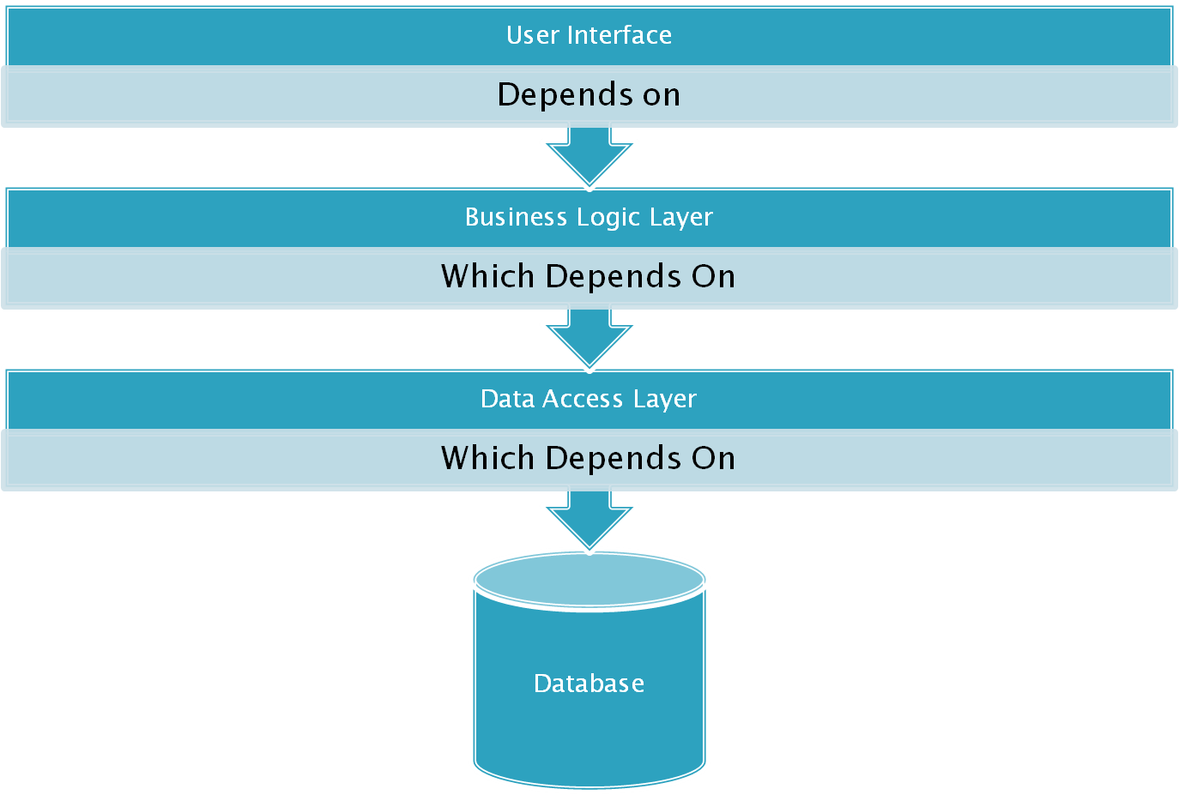

Slide 5

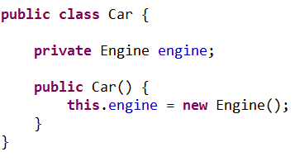
The car makes a new engine when the car is being constructed

Slide 6
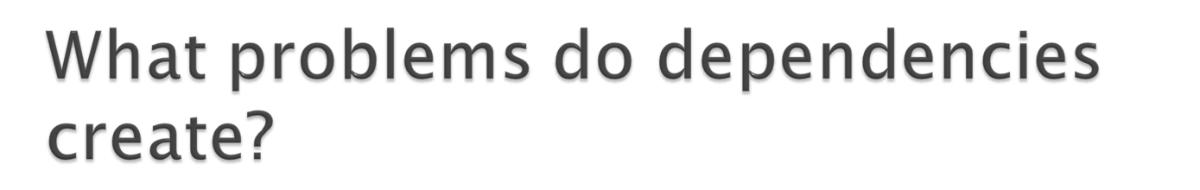
Code is tightly coupled
Difficult to isolate when testing
Difficult to maintain

Slide 7

The ability to supply (inject) an external dependency into a software component.
Types of Dependency Injection:
Constructor
Setter Method
Properties Injection

Slide 8

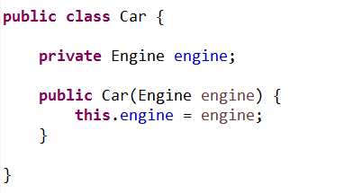
We move the creation of the dependency into whatever creates the object in the first place
The created engine is now slotted into the car when the car is being constructed
But why? dependencies.
Better separation of code
Better testability through stubs and mock objects
The object doesn’t need to know implementation details of it’s dependency.

Slide 9

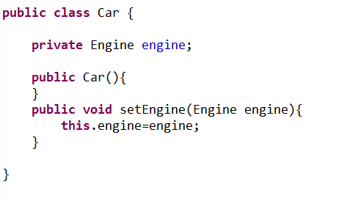
Injecting an Engine through the setter.

Slide 10
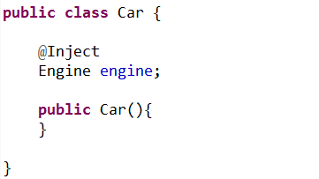
Properties Injection
Injecting an engine through property

Slide 11
Interfaces dependencies
At the moment, our class depends on an instance of an Engine
This Engine class is fully functioning
This could be something like a database connection.
But what if we wanted to swap this for an ElectricEngine? What about a DieselEngine?

Slide 12
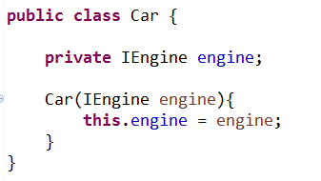
Interfaces dependencies
Now our class doesn’t care what sort of engine it gets, as long as it looks like and behaves like an engine, it’s good enough.
As our IEngine interface exposes everything we need to access on the engine, we can continue as normal

Slide 13

Pros
Loosely Coupled
Increases Testability
Separates components cleanly
Allows for use of Inversion of Control Container
Cons
Increases code complexity
Some Jr. Developers find it difficult to understand at First
Can Complicate Debugging at First
Complicates following Code Flow

Slide 14
inversion of control

Slide 15

Sometimes referred to as Dependency Inversion Principle (DIP)
The principle states that high level or low level modules should not depend upon each other, instead they should depend upon abstractions.
Specific implementations (object instances) are deferred to a higher level of abstraction of control.
Examples:
Parent class(es)
A Container
Referred to as the “Hollywood Principle”
“Don’t call us, we will call you.”

Slide 16
1. Inversion of control is a pattern used for decoupling components and layers in the system. The pattern is implemented through injecting dependencies into a component when it is constructed. These dependences are usually provided as interfaces for further decoupling and to support testability. IoC / DI containers such as Spring IoC(Java), Castle Windsor (.NET) which can be used for providing IoC. These tools provide extended features above and beyond simple dependency management, including lifetime, AOP / Interception, policy, etc.
2. a. Alleviates a component from being responsible for managing it's dependencies.
b. Provides the ability to swap dependency implementations in different environments.
c. Allows a component be tested through mocking of dependencies.
d. Provides a mechanism for sharing resources throughout an application.
3. a. Critical when doing test-driven development. Without IoC it can be difficult to test, because the components under test are highly coupled to the rest of the system.
b. Critical when developing modular systems. A modular system is a system whose components can be replaced without requiring recompilation.
c. Critical if there are many cross-cutting concerns which need to addressed, partilarly in an enterprise application.

Slide 17
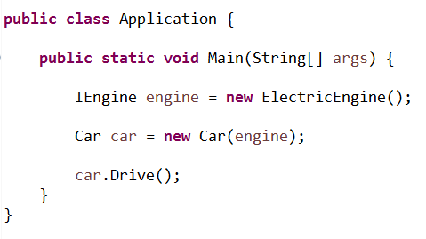
Inversion of Control dependencies.
Dependency Injection removes the need for building dependencies from the class which depends on them
The problem is just shifted to the caller.
We need to know the concrete implementation of the Engine at compile time
With Inversion of Control, we delegate the management of the entire lifecycle of the objects to a container(Application.class).

Slide 18
IoC Containers.
Castle Windsor (.NET)
Spring (Java)
Guice ( Java)
Autofac (.NET)
Ninject (.NET) Prism (.NET)
StructureMap (.NET)

Slide 19

Spring Framework
The Spring Framework is an application framework and inversion of control container for the Java platform. The framework's core features can be used by any Java application, but there are extensions for building web applications on top of the Java EE (Enterprise Edition) platform.
Spring offers
+Dependency Injection
Also known as IoC (Inversion of Control)
+Aspect Oriented Programming
Runtime injection-based
+Portable Service Abstractions
The rest of spring
ORM, DAO, Web MVC, Web, etc.
Allows access to these without knowing how they actually work

Slide 20
Dependency Injection
The technology that actually defines Spring (Heart of Spring).
Dependency Injection helps us to keep our classes as indepedent as possible.
The Inversion of Control (IoC) is a general concept, and it can be expressed in many different ways and dependency Injection is merely one concrete example of Inversion of Control.
“Dependency injection is a pattern where the container passes objects by name to other objects, via either constructors, properties, or factory methods.”

Slide 21
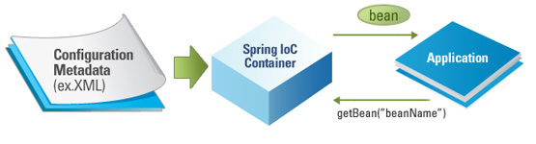
Dependency Injection IoC Container
The Spring container (IoC Container) is at the core of the Spring Framework.
The container will create the objects, wire them together, configure them, and manage their complete lifecycle from creation till destruction.

Slide 22
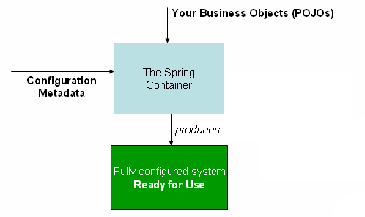
Dependency Injection IoC Container
The container gets its instructions on what objects to instantiate, configure, and assemble by reading configuration metadata provided.
The configuration metadata can be represented either by:
XML
Java annotations
Java Code

Slide 23
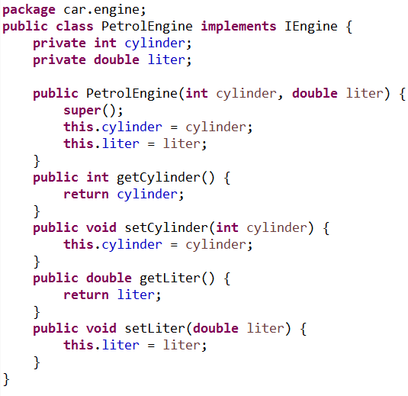
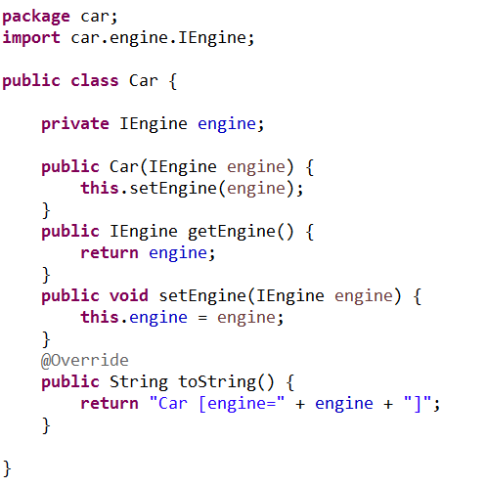
Dependency Injection Code Example
To instantiate the above classes, one way is to do the usual new operator like new Car() or new PetrolEngine() OR we can use the Spring dependency injection to instantiate these classes and set the properties accordingly.

Slide 24

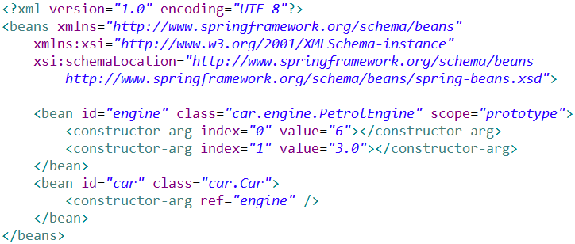

Dependency Injection Code Example

Slide 25
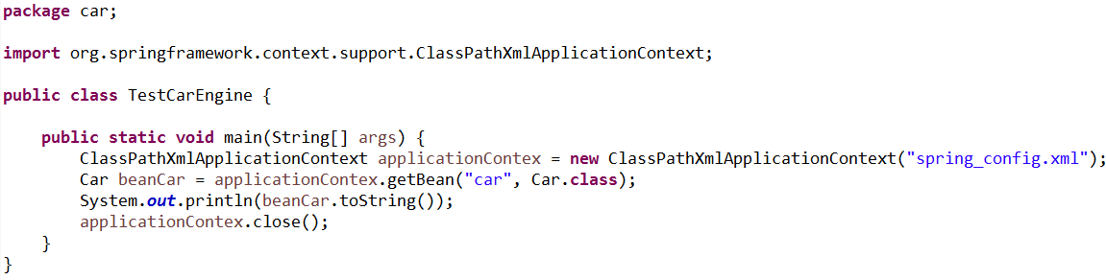
Dependency Injection Code Example
Spring`s ClassPathXmlApplicationContex is the commonly used Object that hold the
information of all the beans that it instantiates

Slide 26
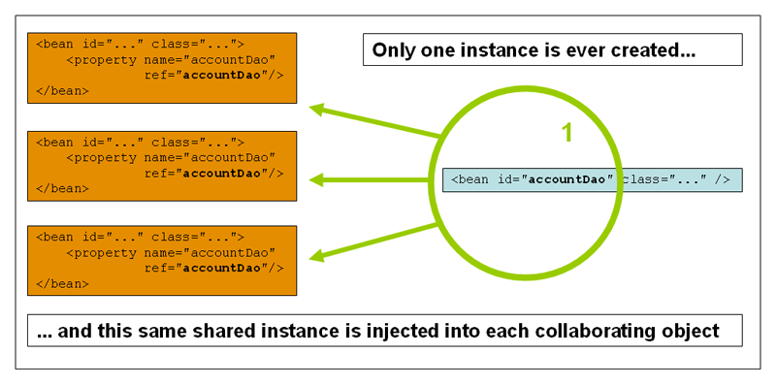
Dependency Injection Bean Scopes
Scope | Description
Singleton | (Default) Scopes a single bean definition to a single object instance per Spring IoC container.
Prototype | Scopes a single bean definition to any number of object instances.

Slide 27
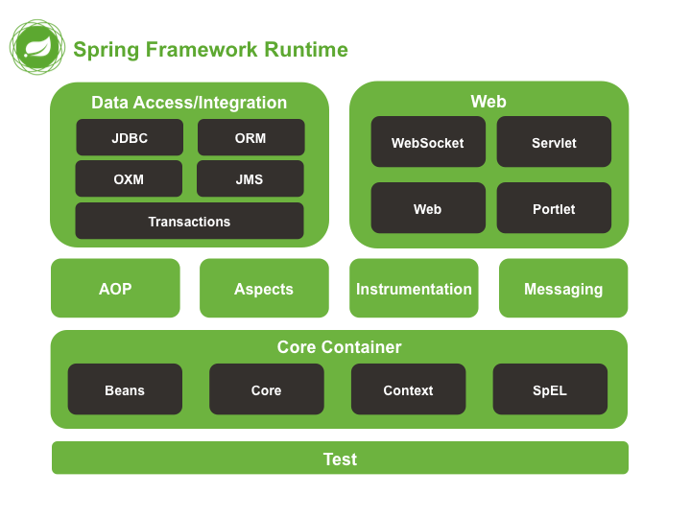

Slide 28

Advantages of Using Spring Framework
Open source
Lightweight and fast
Moduler structure
Low coupling thanks to Dependency Injection
Resuable software
AOP support
Stable and lots of resources
Projects that make our life easier like Spring Security

Slide 29

Container
Spring: https://docs.spring.io/spring/docs/current/spring-framework-reference/html/beans.html
Dependency Inversion Principle (DIP)
http://principles-wiki.net/principles:dependency_inversion_principle

Slide 30
The end

